Slide 1
Exercise 5
What is the object of using equalizers on dc machines?
[2 marks]
The total number of conductors in each parallel path of an 8-pole simple lap winding must be greater than 94 and less than 102. The number of slots per pole must also be greater than 12 and less than 18. Not less than 10 and not more than 15 equalizers must be used. Determine the maximum and minimum number of conductors per slot [1 mark]
and proceed to give the following details of a suitable winding:
  the number of conductors per slot [1 mark]
  the number of coil-sides per layer (u) which should be greater than 1 and the number of turns in a coil [1 mark]

Slide 2
  the number of slots [2 marks]
  the number of commutator bars or segments [2 marks]
  the number of equalizers [1 mark]
  the coils which must be connected to equalizer No. 1 and equalizer No. 2. [2 marks]
The 2-circuit armature of a 4-pole generator has 51 slots, each containing 20 conductors. What will be the voltage generated in the machine when driven at 1500 rev/min, assuming the useful flux per pole to be 0.007 Wb?
[3 marks]
Substitute the following into votage equation:
N=1500, p = 2, a = 1, Z = 51 x 20, phi = 0.007]

Slide 3
Determine the maximum number of conductors per slot: use z_{max}= 101 and s_{min}=13 [7.7= 6 since it should not exceed 7.7 and it should be even]
and minimum number of conductors per slot [1 mark]: use z_{min}= 95 and s_{max}=17 [5.6= 6 since it should be above 5.6 and it should be even]
and proceed to give the following details of a suitable winding:
  the number of conductors per slot [min = 6, max = 6 so ans = 6]
the number of coil-sides per layer (u) which should be greater than 1 and the number of turns in a coil [With 6 conductors in a slot the arrangement is either 3x1 or 1x3 in one layer. Therefore u = 3 and no of turns = 1]

Slide 4
  the number of slots [Since the number of conductors per pole s must not exceed 101 and must not be less than 95, with 6 conductors in a slot, s_{max}=101/6 = 16.8 = 16 and s_{min}=95/6 = 15.8=16. Therefore s =16 and S = 16 x 8 = 128]
  the number of commutator bars or segments [= C= S x u=128 x 3= 384]
the number of equalizers [Pitch of tapping points =(C/p) x(1/no of equalizers) = (384/4)x(1/no of equalizers) = 96/no of equalizers. For this to be an integer no. of equalizers must be 12]
  the coils which must be connected to equalizer No. 1 and equalizer No. 2. [C/p = 96 and pitch of tapping points = 96/12 = 8. Therefore to equalizer 1: 1, 97, 193, 289 and to equalizer 2: 9, 105. 201, 297]

Slide 5
3-phase armature windings
The winding is composed of conductors in a number of evenly spaced slots around the gap surface of the stator.
The conductors are arranged in 3 balanced sections.
The conductors in a section are interconnected to form a phase winding.

Slide 6
Definitions
Phase or coil groups
  Coils staggered at one-slot interval when connected in series form a phase or coil group.
  The voltage of a coil group is given by the phasor sum of the constituent individual coil emfs, which because they are staggered, have emfs displaced in time phase.
Coil voltage:
  The voltage of a coil is obtained by the product of the number of conductors in the coil and the voltage per conductor when it is full-pitch.
  If the coil is not full-pitch the product has to be multiplied by coil-span factor

Slide 7
Phase winding:
  The phase or coil groups may be connected in series, in parallel or in series-parallel to obtain a phase winding.
  The phase or coil groups of a phase winding are spaced uniformly around the stator.
  The voltage of a phase winding is the arithmetic sum of the voltages of the phase or coil groups (per parallel i.e. when they are parallel as well)
Phase spread or phase groupings:
  The way the conductors or coil-sides are arranged in 3-balanced sections gives what is called 60º or 120º phase spread or phase group.

Slide 8
  For the 60º phase spread, the coil-sides over two pole pitches, i.e. 360º are divided into 6 groups, each group spreading over 60º.
  The groups are assigned to the three phases A, B and C in the sequence A, C’, B, A’, C and B’.
  For a given phase X, the conductors are interconnected such that the current in the conductors in section X and the current in conductors in section X’ flow in opposite directions.
  In the case of the 120º phase spread, the coil-sides over two pole pitches are divided into 3 groups, each group spreading over 120º.

Slide 9
  For two-layer winding, the groupings of coil-sides given in Fig. 11 represent the groupings of the top-layer coil-sides only.
  Coils have return conductors a pole-pitch or less away to give turns. For this reason, the 120º phase spread is possible with two-layer winding but not possible with single-layer winding.
  With 60º phase spread, both single- and two-layer windings can be used.
  In ac winding, u = 1, hence C = S in the two-layer winding.

Slide 10
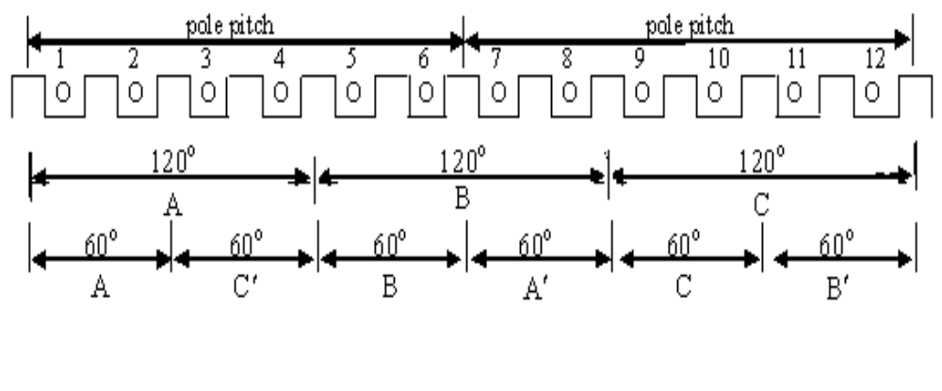
Fig. 11 Phase groupings

Slide 11
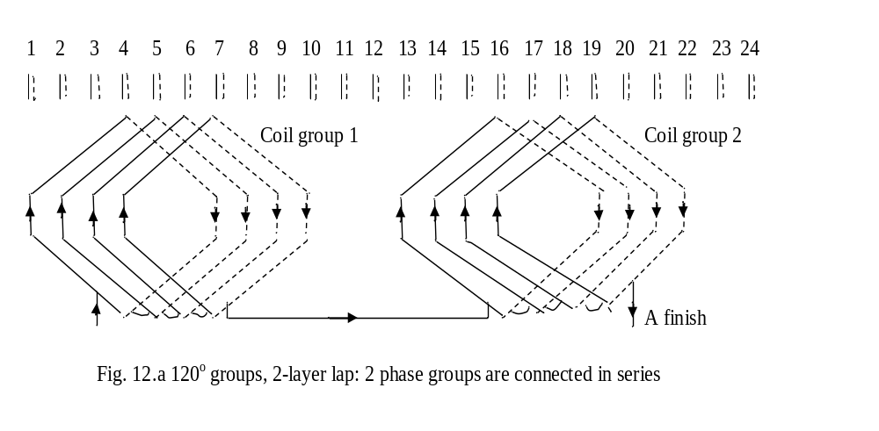
Examples of 3-phase windings

Slide 12
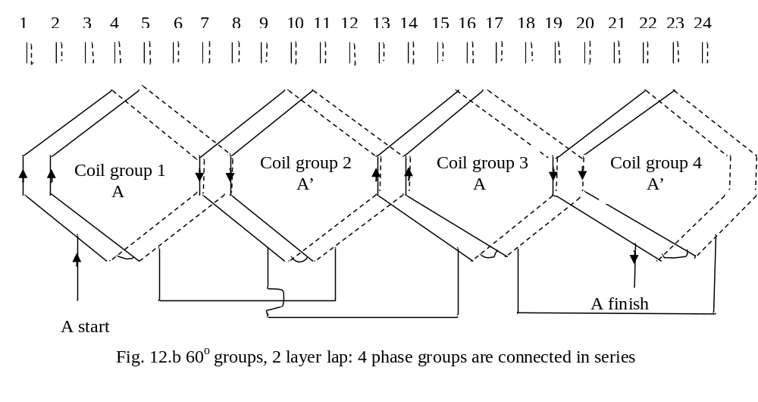
Examples of 3-phase windings

Slide 13
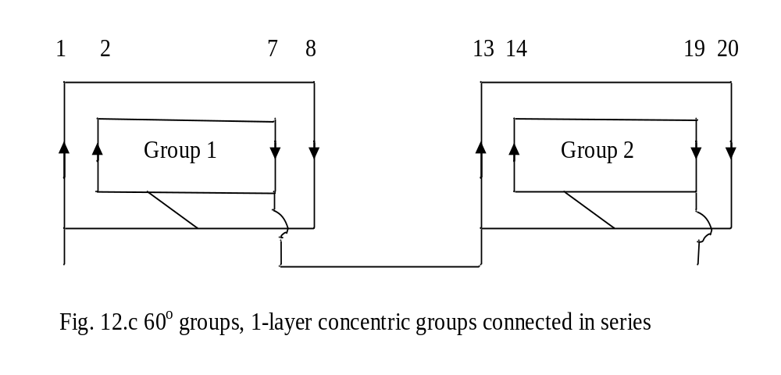
Examples of 3-phase windings

Slide 14
The armatures of nearly all synchronous generators and of most induction motors above a few horse powers are wound with 2-layer windings.
The most usual phase spread or phase grouping or coil group is 60º.
The type of coil used in modern machines is lap.

Slide 15
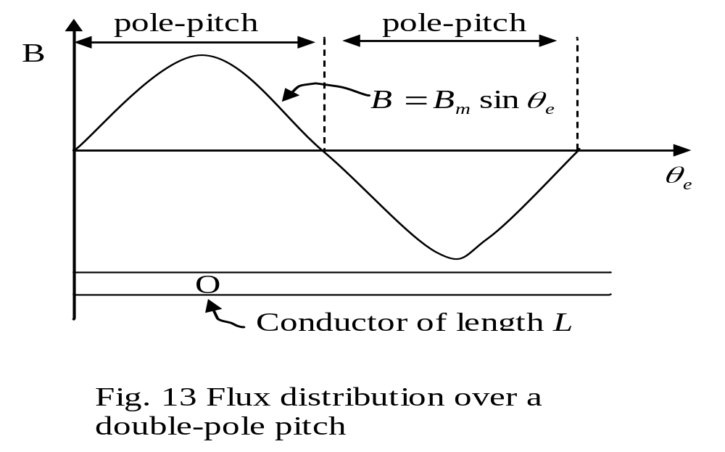
Emf induced in armature coil
Fig. 14 shows two pole-pitches of 2p-pole machine in which the spatial distribution of the gap flux is sinusoidal.

Slide 16
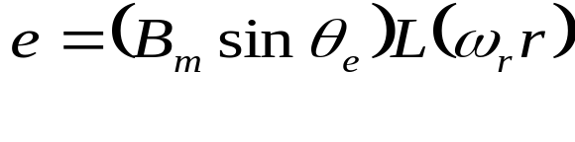
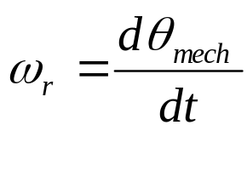
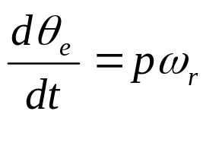
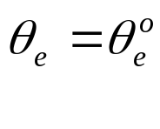
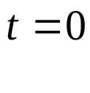
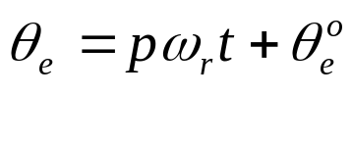
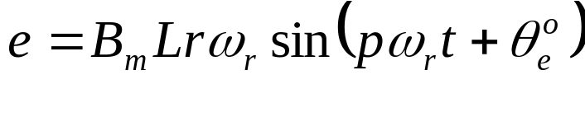
The flux is supposed to be stationary and
The conductor is supposed to be moving past it speed u = ωr
The voltage induced in the conductor is
The angular velocity . Hence
Suppose that the conductor is located at when
Then its location at the time t is
Substituting this in the emf equation gives the steady-state voltage as a function of time as

Slide 17
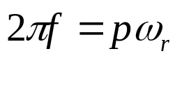
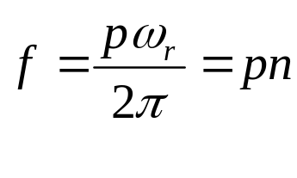

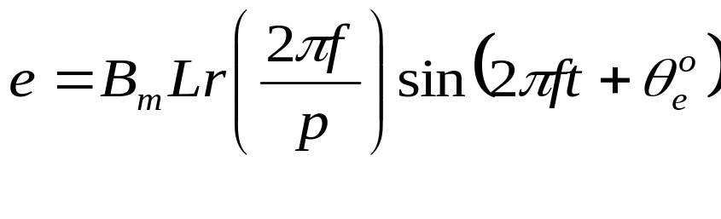
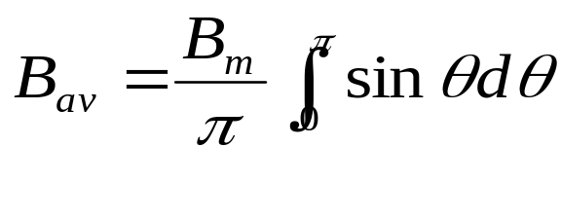
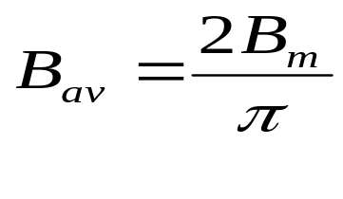
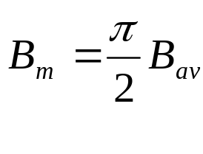
Let Then
n is the speed of the conductor or armature in rev/s
If we substitute this into
we obtain
The average density in the air gap or
From which

Slide 18
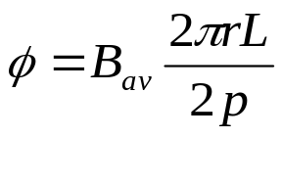
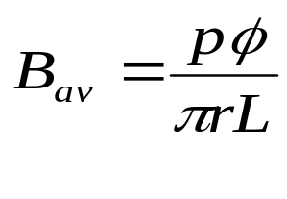
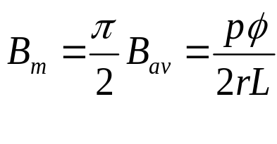
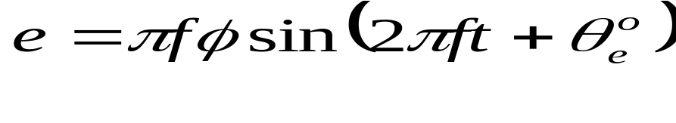
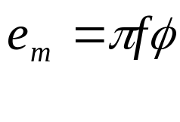
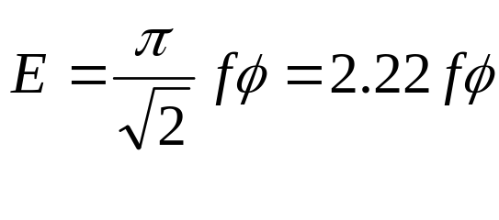
Total flux per pole from which
Therefore
Substituting this into
yields
The peak emf of a conductor
The rms value

Slide 19
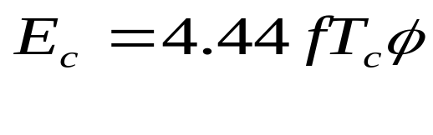
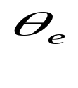
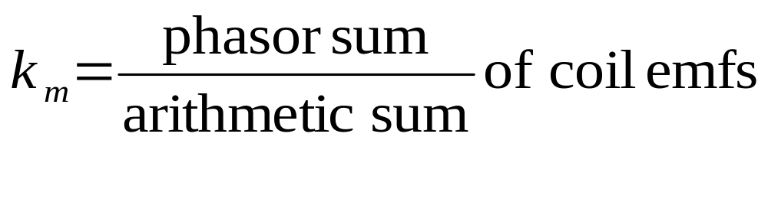
For a coil of T_{c} turns the number of conductors = 2T_{c}
Therefore for a full-pitch coil of T_{c} turns the rms coil emf is
Winding factors
Distribution factor
  The coil voltages all have the same magnitude and frequency but they are not in phase with each other. (Because their zeroes are different)
  The emf of a phase or coil group is the phasor sum of the constituent individual coil emf.
  The distribution factor is defined as

Slide 20
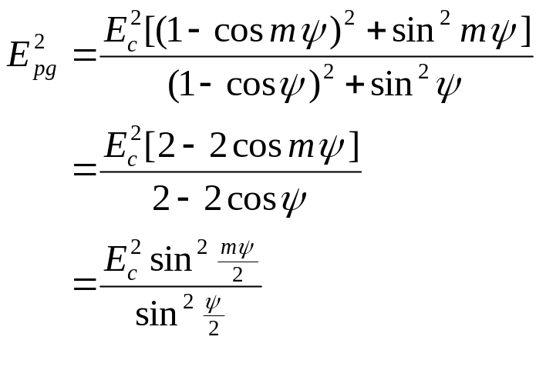

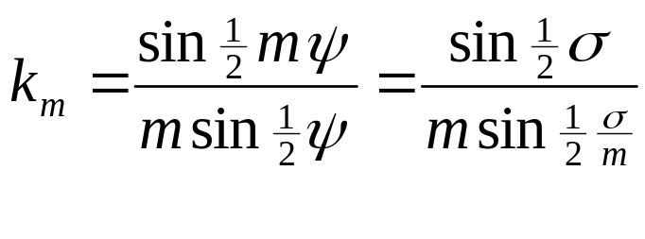
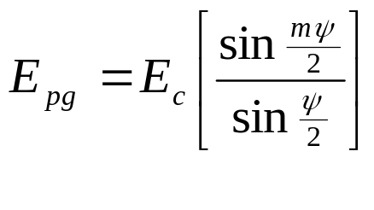
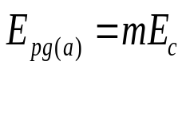
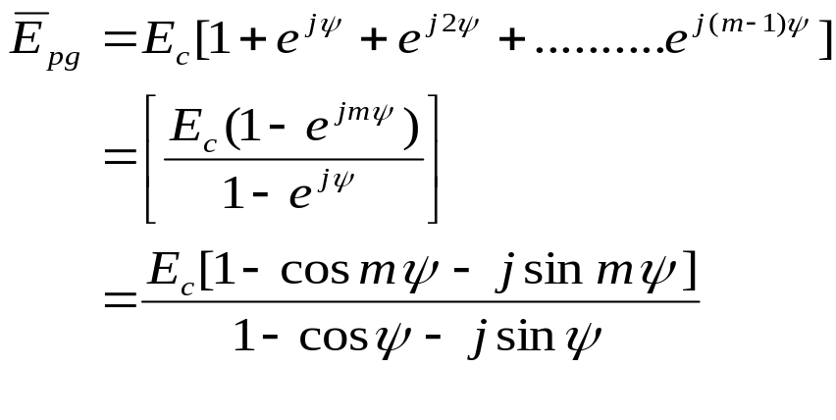
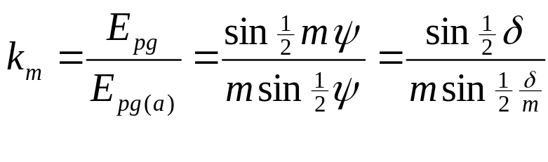
Suppose a phase group to
comprise m full-pitch coils
and the slot angle is ψ .
Then
Proof
  The phasor sum - Arithmetic sum
  - The distribution factor

Slide 21
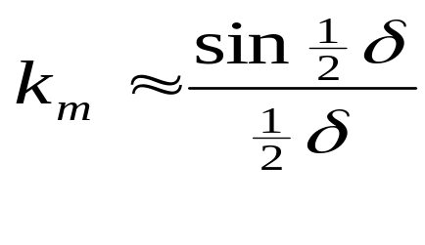
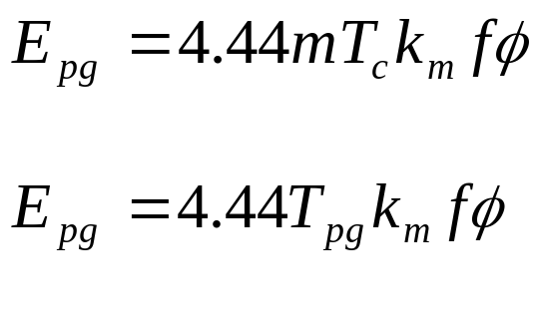
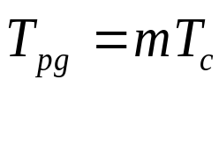
When ψ is small. Then
The phase group of the m full-pitch coils will produce the rms emf
where
is the total turns in series per phase group.

Slide 22
Coil span factor
  A coil may be under- or over-pitched. Such a coil is said to be chorded.
  A coil is usually short-pitched.
  Short-pitched coils have amount of copper in the end-connections reduced and harmonics in the phase emfs reduced or suppressed.
  A coil pitch of 0.8 to 0.9 per unit is usually employed on 2-layer windings and this reduces the 5th and 7th harmonics considerably.
  Fig. 14 shows the arrangement of phase A conductors in a 2-layer, 60º winding over two pole-pitches. There are 6 slots per pole or 2 slots per pole per phase (= m). The arrangement W is for full pitch coils and the arrangement Z is for short-pitched or chorded coils. The chorded coils are short-pitched by 1 slot interval which corresponds to electrical

Slide 23
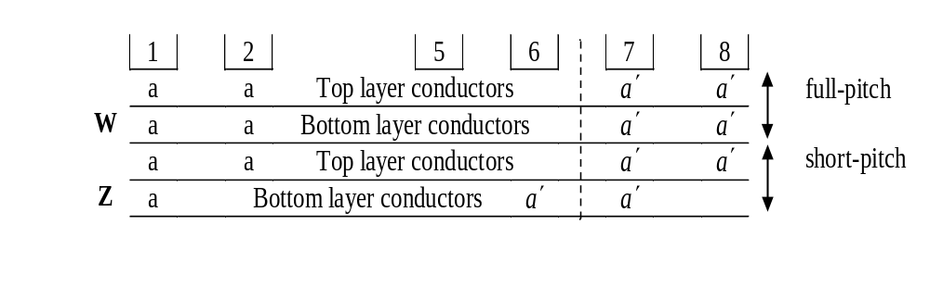
  Fig. below shows the arrangement of phase A conductors in a 2-layer, 60º winding over two pole-pitches.
  There are 6 slots per pole or 2 slots per pole per phase (= m).
  The arrangement W is for full pitch coils and the arrangement Z is for short-pitched or chorded coils.
  The chorded coils are short-pitched by 1 slot interval which corresponds to ε = 180/6 = 30º electrical

Slide 24
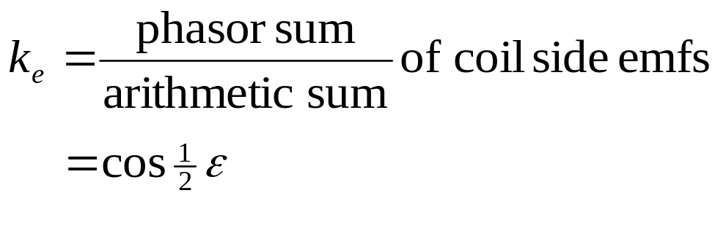
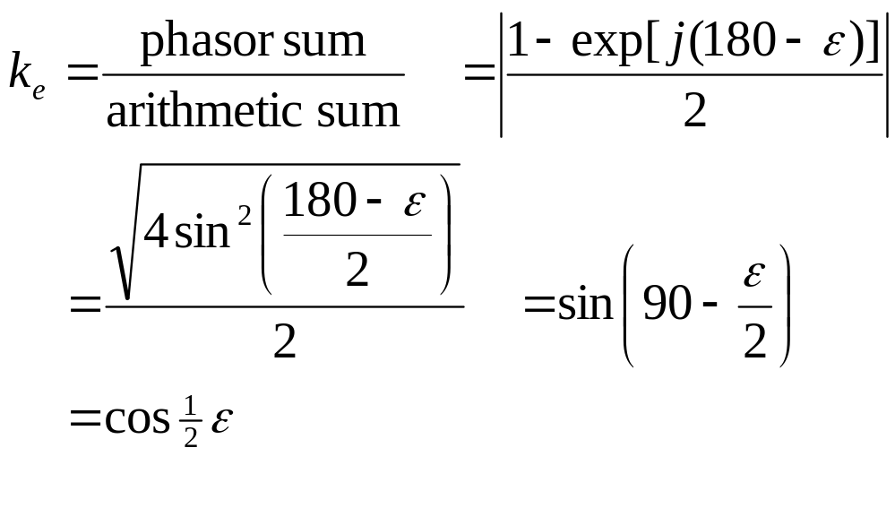
If the coil span is not a full pitch, then the voltage of a coil is given by the phasor sum of the conductor emfs in its two sides.
Let the coil span depart from its full-pitch value by ε electrical degrees. Then the coil-span factor
Proof

Slide 25
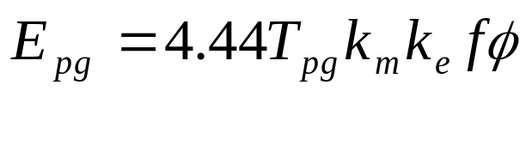
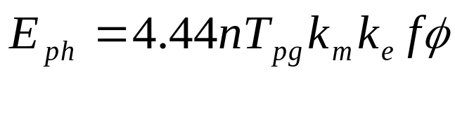
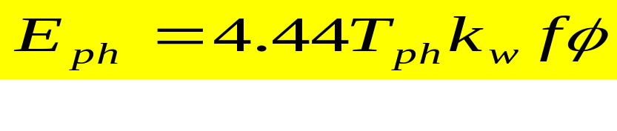
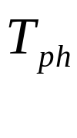
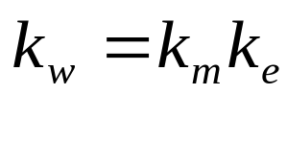
Phase winding emf
A phase or coil group consisting of short-pitched coils will produce the rms emf
A phase winding consisting of such n phase groups in series will have a phase voltage
or
Where
is the total turns in series per phase and
is the winding factor.

Slide 26
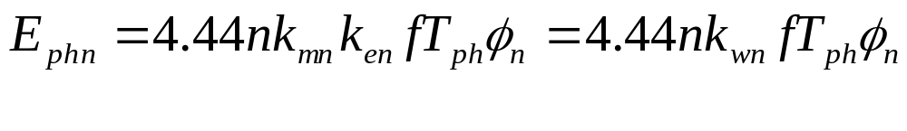
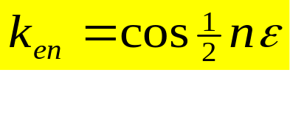
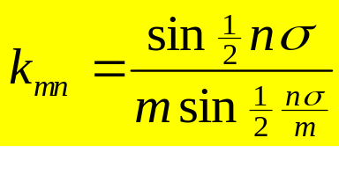
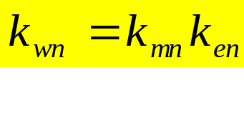
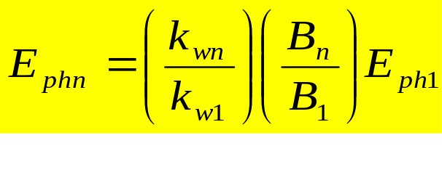
  Harmonic voltages
The gap-flux density curve which is not purely sinusoidal can be analysed into fundamental and harmonic densities B₁ , B₃, B₅, B_{7,} , , , etc.
The emf of a phase due to n^{th} harmonic is
  where , and
A more useful form is
The subscript 1 refers to the fundamental component of the flux.

Slide 27
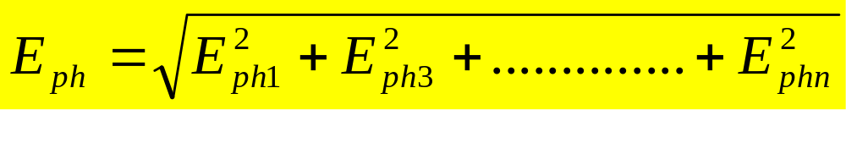

The rms phase emf in this case will be
The line emf in star connection is
with E_{ph} calculated as above but omitting all triplen (i.e. all odd multiples of 3) harmonic values.

